Slide 1
NAME : ARAVINDHAN A
ROLL NO : 813821104013

Slide 2
Handwritten Digit Recognition using MNIST Dataset
INTRODUCTION
The MNIST dataset is a classic benchmark dataset in the field of machine learning and computer vision. It stands for Modified National Institute of Standards and Technology database. The dataset consists of a large number of handwritten digits that have been manually labeled.

Slide 3


AGENDA
Researchers in Machine Learning and Computer Vision
Educational Institutions
Developers of OCR (Optical Character Recognition) Systems
Product Developers
Accessibility Tools
Fnancial Institutions
Medical Imaging
Manufacturing and Quality Control
3/21/2024 Annual Review

Slide 4

PROBLEM STATEMENT
Develop a machine learning model to recognize handwritten digits from the MNIST dataset. The model should take an input image of a handwritten digit and output the corresponding digit class (0-9).

Slide 5

PROJECT OVERVIEW
The project aims to develop a machine learning model capable of recognizing handwritten digits from the MNIST dataset. Handwritten digit recognition is a fundamental problem in computer vision and serves as a foundational task for more complex image recognition systems.

Slide 6

WHO ARE THE END USERS?
Researchers in Machine Learning and Computer Vision
Educational Institutions
Developers of OCR (Optical Character Recognition) Systems
Product Developers
Accessibility Tools
Fnancial Institutions
Medical Imaging
Manufacturing and Quality Control

Slide 7

YOUR SOLUTION AND ITS VALUE PROPOSITION
Dataset Description: Introduce the MNIST dataset, which consists of 28x28 grayscale images of handwritten digits (0-9), along with their corresponding labels.
Task Definition: Define the task as a classification problem where the goal is to classify each image into one of the ten digit classes.
Preprocessing: Discuss preprocessing steps such as resizing, normalization, and data augmentation, which are often applied to enhance model performance.
Model Selection: Explore various machine learning and deep learning models suitable for the MNIST dataset. This may include traditional classifiers (e.g., SVM, k-NN), shallow neural networks, convolutional neural networks (CNNs), and more advanced architectures.
Training Process: Explain the training process, including model compilation, optimization algorithms (e.g., SGD, Adam), hyperparameter tuning, and monitoring training/validation metrics.

Slide 8
Evaluation Metrics: Describe evaluation metrics used to assess model performance, such as accuracy, precision, recall, F1-score, and confusion matrix analysis.
Performance Comparison: Compare the performance of different models and approaches on the MNIST dataset. Highlight strengths and weaknesses of each approach.
Overfitting and Regularization: Address overfitting issues and discuss regularization techniques (e.g., dropout, L1/L2 regularization) employed to improve model generalization.
Hyperparameter Tuning: Discuss techniques for hyperparameter tuning, including grid search, random search, and Bayesian optimization, to find optimal model configurations.
Deployment Considerations: Touch upon deployment considerations, such as model size, inference speed, and hardware requirements, especially for real-time applications.
Future Directions: Explore potential areas for further research and improvement, such as transfer learning, ensemble methods, and model compression techniques.

Slide 9
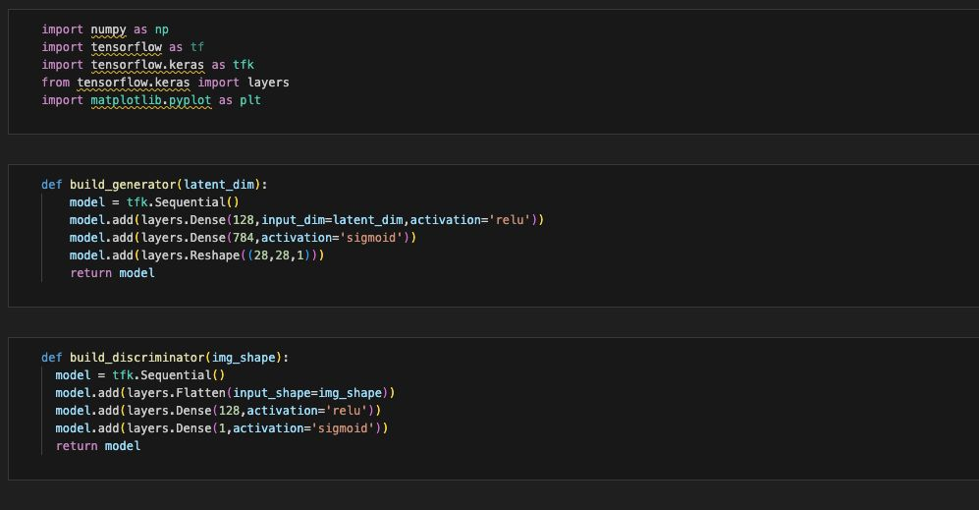
MODELLING

Slide 10
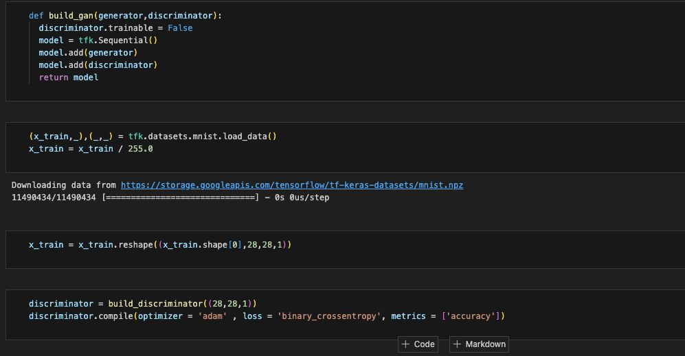

Slide 11
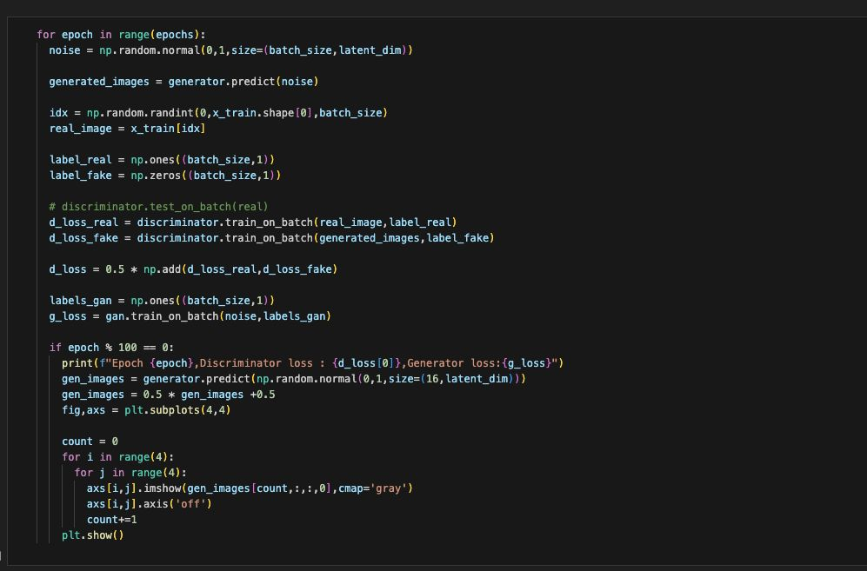

Slide 12
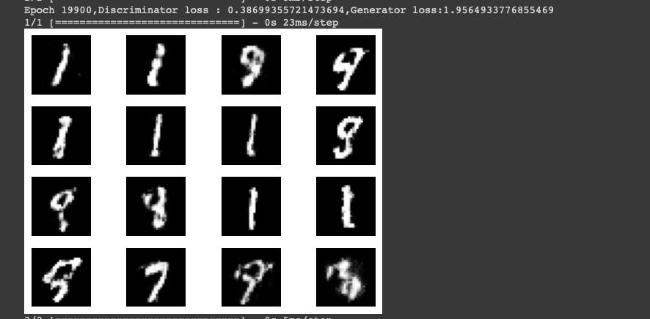
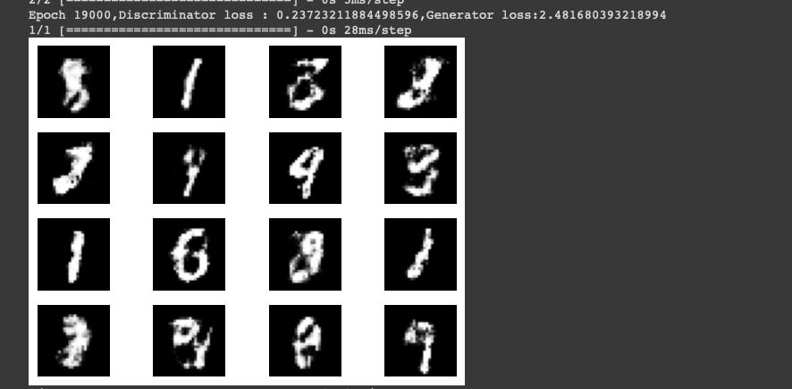
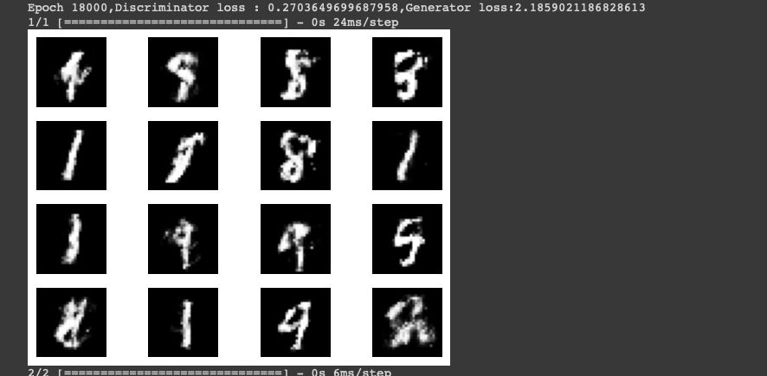
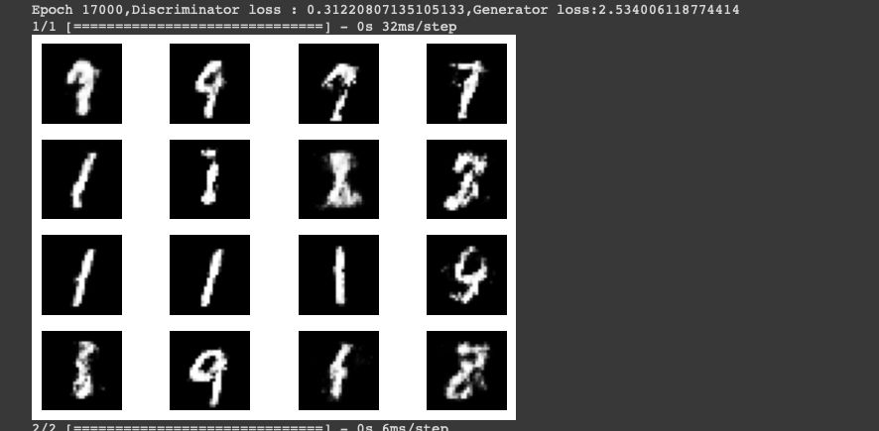
OUTPUT

Slide 13
RESULTS
Accuracy
Precision and Recal
F1-Score
Confusion Matrix
Classification Report
ROC Curve and AUC
Training and Validation Curves
Demo Link

Slide 14
RESULTS
The result for the MNIST problem is typically presented as a combination of these performance metrics, along with visualizations to facilitate interpretation and comparison across different models and approaches. Additionally, the trained model's predictions on unseen data samples may also be showcased to demonstrate its effectiveness in classifying handwritten digits accurately.

